Slide 1
Correlation in scatterplots
“correlation does not equal causation”

Slide 2
Review
Last lesson we looked at constructing scatterplots
Dependent variables rely on the other variable, and go on the x-axis
Independent Variables act on their own, and go on the y-axis.
Scatter plot can be strong or weak, positive or negative and linear or not.

Slide 3
Bivariate data
Scatter plots can be given a line of best fit, also known as a trend line.
This line helps to illustrate wether the data is linear or not.
A trend line should pass through the middle of most data, and have an equal number od points above and below.

Slide 4
Using our graph from the previous lesson, lets look at a trend line
Daily Temperature (Cº) | Drinks sold
18 | 160
22 | 200
24 | 250
33 | 450
30 | 430
28 | 300
29 | 360
17 | 150
23 | 230
27 | 250
We can see our data is linear, and that there are 5 points above, and 5 points below the line.
Similar to linear equations, going up and to the right, we know our trend is positive.

Slide 5
Bivariate data
Using our trend line, we can either interpolate, or extrapolate our data.
Interpolation is the use of a trend line to estimate results below our maximum known data
Extrapolation is using our trend line to continue further, and make prediction outside of our known data
WARNING- when extrapolating data, we assume that the relationship is linear, and that there is a causal relationship

Slide 6
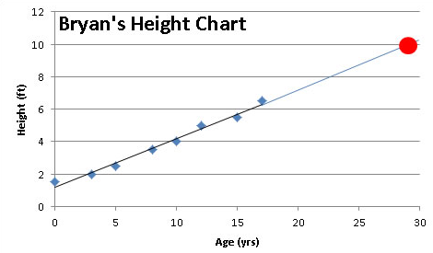
Bryans growth chart
Bryan mapped his growth on a chart, and constructed the scatterplot below.
He fit a trend line to the data to predict how tall he would be when he was 20, and then 25.
Based on this EXTRAPOLATION, we would have a 9ft tall Bryan.
What is wrong with this?
The trend is linear, but Bryan will stop growing at a constant rate around 19 or 20, so he should level off. Because we extrapolated the results, we got an unrealistic answer.

Slide 7
Bivariate data
jnkmlxsdfved

